Slide 1

Fingerprints
Forensic Science
T. Trimpe 2006 http://sciencespot.net

Slide 2
Fingerprint Principles
According to criminal investigators, fingerprints follow 3 fundamental principles:
A fingerprint is an individual characteristic; no two people have been found with the exact same fingerprint pattern.
A fingerprint pattern will remain unchanged for the life of an individual; however, the print itself may change due to permanent scars and skin diseases.
Fingerprints have general characteristic ridge patterns that allow them to be systematically identified.

Slide 3
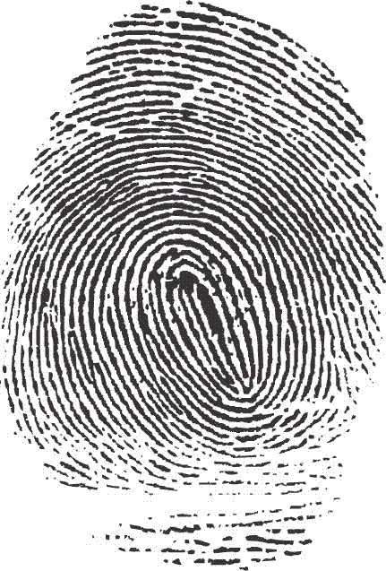
Fingerprint Classes
There are 3 specific classes for all fingerprints based
upon their visual pattern: arches, loops, and whorls.
Each group is divided into smaller groups
as seen in the lists below.
Arch
Plain arch
Tented arch
Loop
Radial Loop
Ulnar loop
Whorl
Plain whorl
Central pocket whorl
Double loop whorl
Accidentical

Slide 4
Interesting Info
Fingerprint Factoid:
60% of people have loops, 35% have whorls,
and 5% have arches
Did you know?
Dactyloscopy is the study of fingerprint identification.
Police investigators are experts in collecting “dactylograms”, otherwise known as fingerprints.
ADD TO NOTES

Slide 5
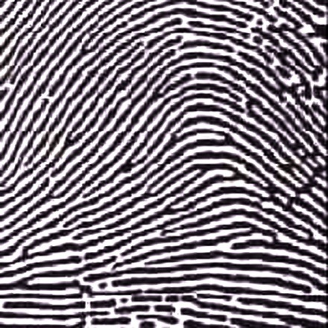
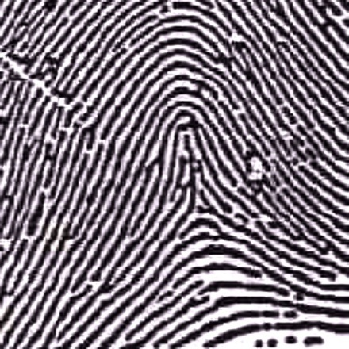
Arches
Arches are the simplest type of fingerprints that are formed by ridges that enter on one side of the print and exit on the other. No deltas are present.
Spike or “tent”
Plain Arch
Ridges enter on one side and
exit on the other side.
Tented Arches
Similar to the plain arch,
but has a spike in the center.

Slide 6
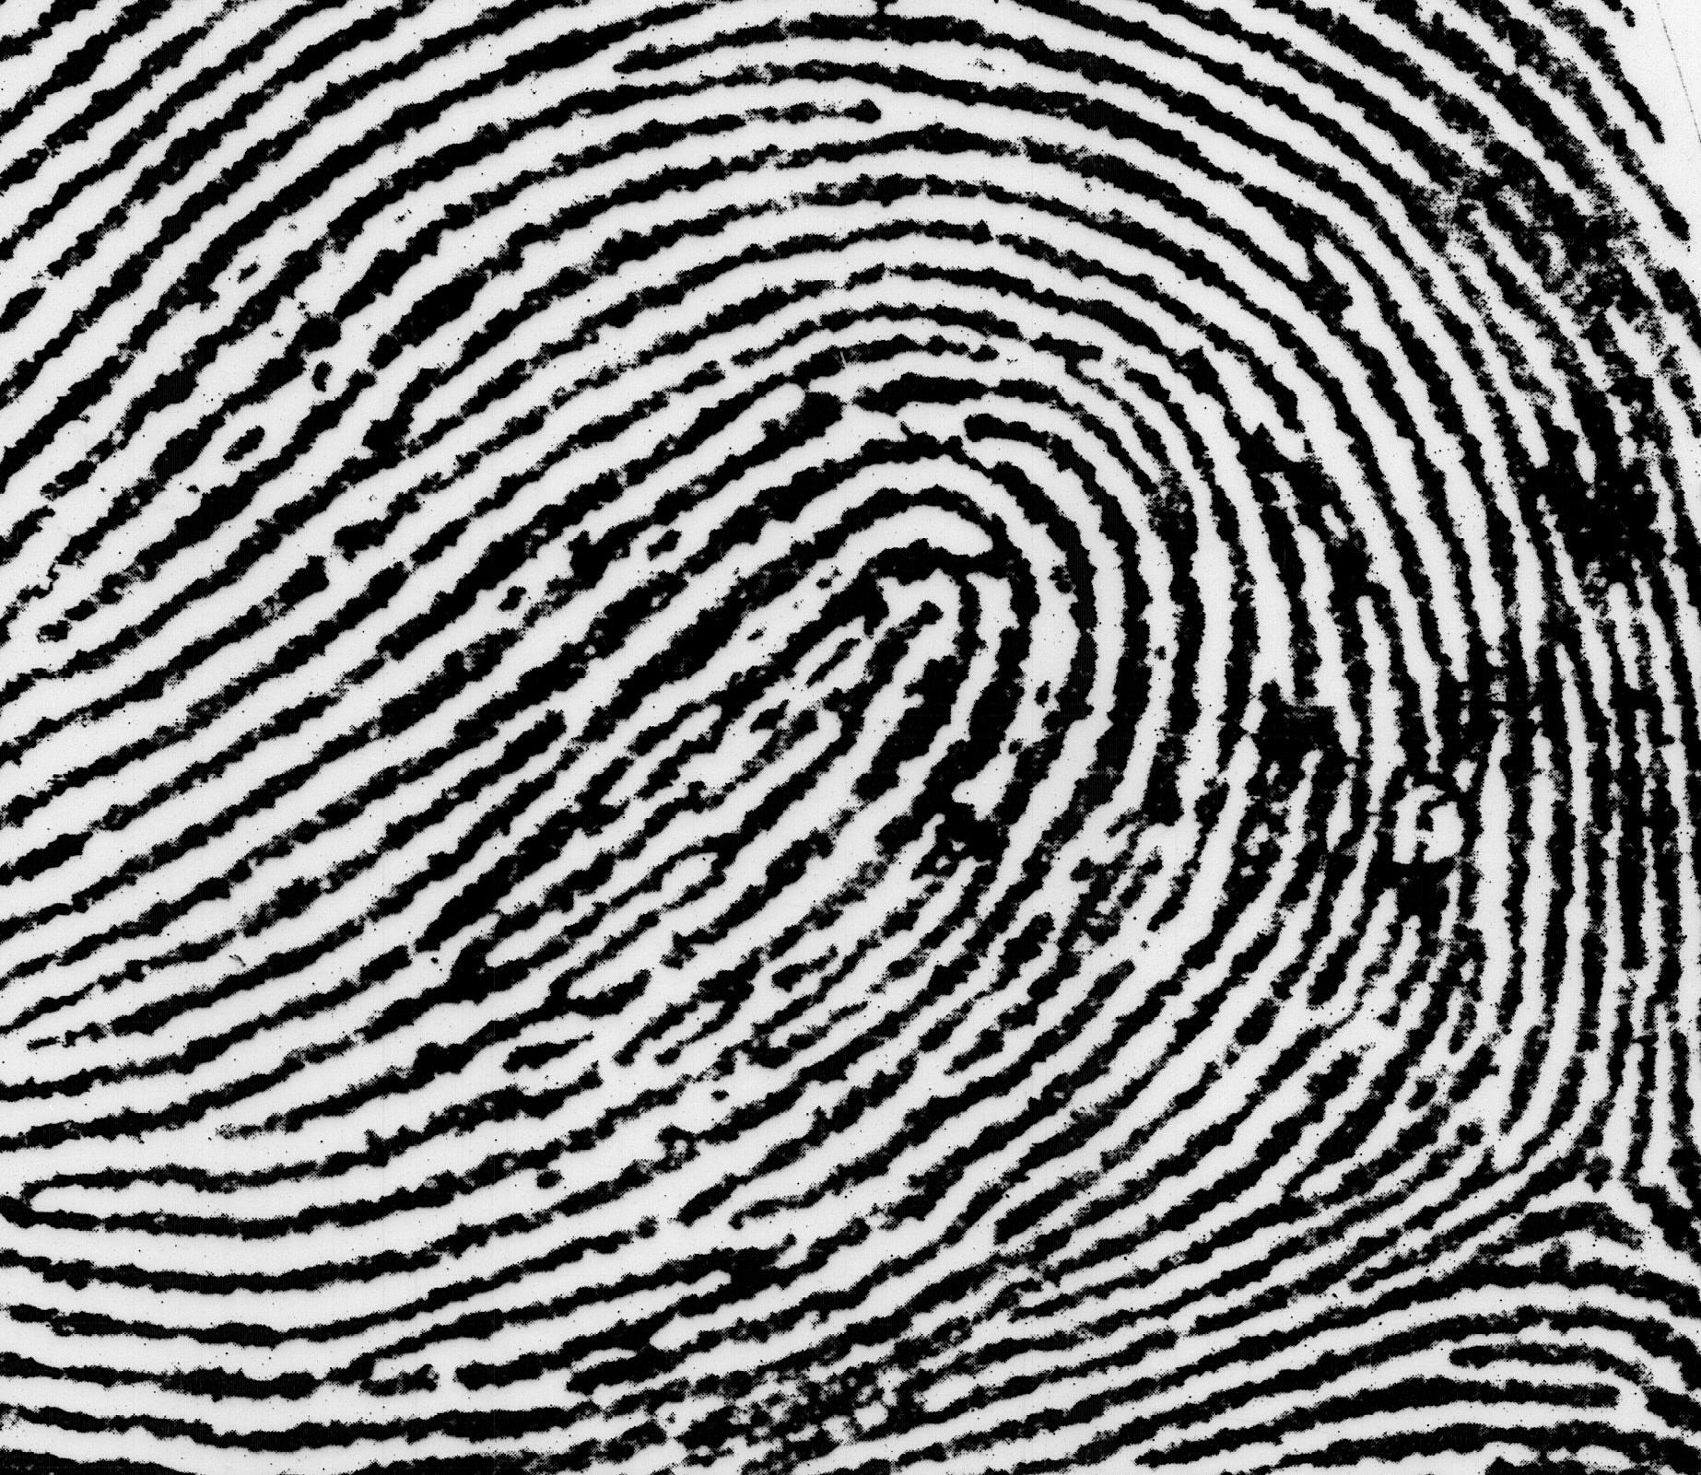
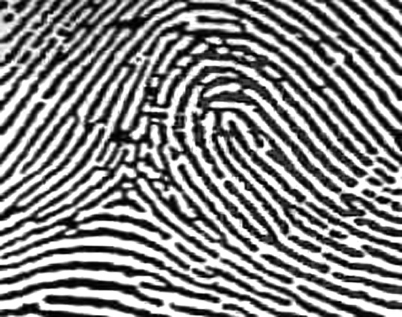
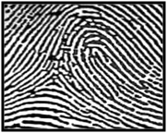
Loops
Loops must have one delta and one or more ridges that enter and leave on the same side. These patterns are named for their positions related to the radius and ulna bones.
Delta
Ulnar Loop (Right Thumb)
Loop opens toward
right or the ulna bone.
Radial Loop (Right Thumb)
Loop opens toward the
left or the radial bone.
NOTE: On the left hand, a loop that opens to the left would be an ulnar loop, while one that opens to the right would be a radial loop.

Slide 7
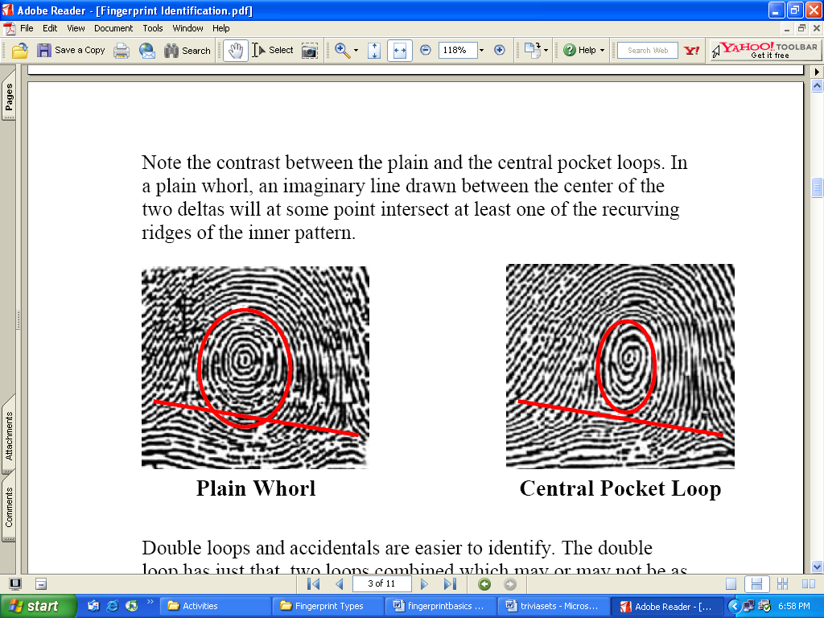
Whorls
Whorls have at least one ridge that makes (or tends to make) a complete circuit. They also have at least two deltas. If a print has more than two deltas, it is most likely an accidental.
Central Pocket Whorl
Plain Whorl
Draw a line between the two deltas in the plain and central pocket whorls. If some of the curved ridges touch the line, it is a plain whorl. If none of the center core touches the line, it is a central pocket whorl.

Slide 8
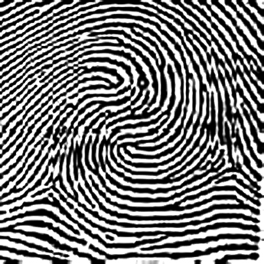
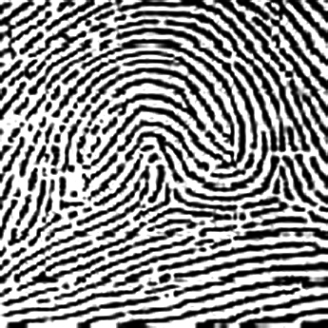
Whorls – Part 2
Double Loop Whorl
Accidental Whorl
Delta
Delta
Double loop whorls are made up of any two loops combined into one print.
Accidental whorls contain two or more patterns (not including the plain arch), or does not clearly fall under any of the other categories.

Slide 9

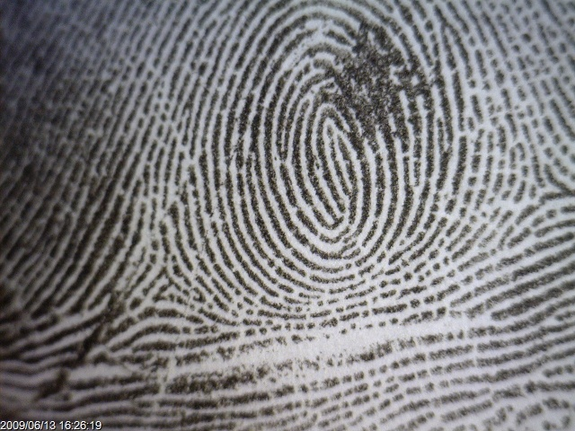
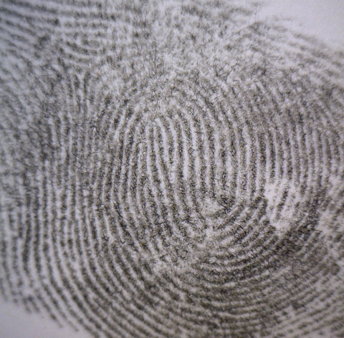

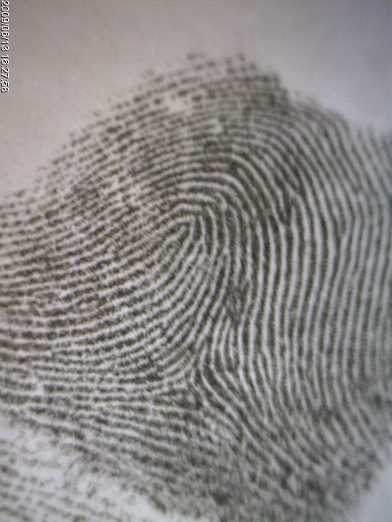

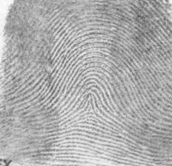
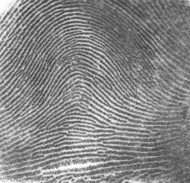



Identify each fingerprint pattern.
Left Hand
Right Hand
Right Hand
Right Hand
Left Hand

Slide 10

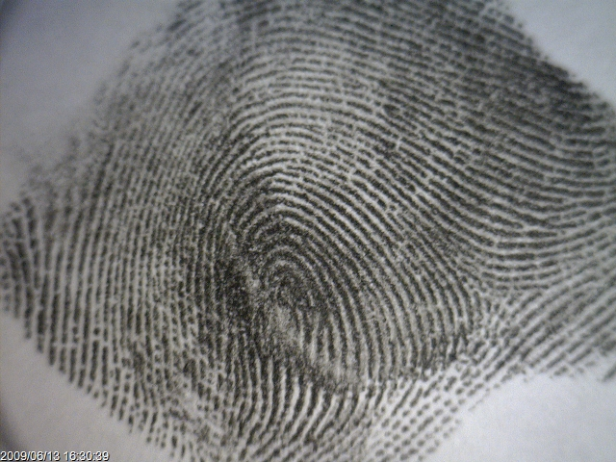
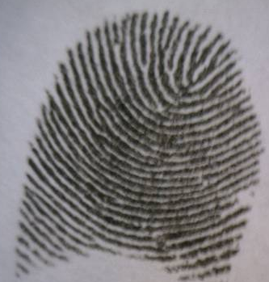
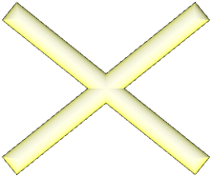
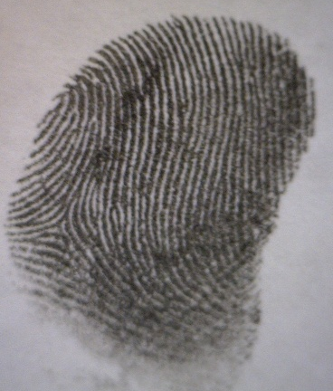

It’s time to make
some prints!
Avoid Partial Prints
GOOD PRINT
Get as much of the top part of your finger as possible!

Slide 11
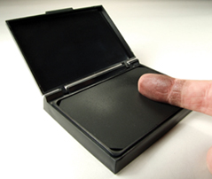
Directions
1st – Roll the “pad” portion of your thumb over the ink pad from the left side of your thumb to the right. You do not have to push down really hard!
2nd – Roll the “pad” portion of your thumb from the left side of your thumb to the right in the correct box on your paper to make a thumbprint.
3rd – Continue this process to make a fingerprint of all ten fingers on the “My Prints” worksheet.
4th –Use your notes and a magnifying lens to help you figure out what type of pattern is found in each of your fingerprints. Label each one with the pattern’s name.

